Slide 1
Rockbuster Stealth, LLC Movie Rental Company
Lindsey Young
Data Analytics Team

Slide 2

Overview & Objectives
Introduction
Objective
Key Questions
Rockbuster Stealth LLC is a movie rental company that used to have stores around the world. They are facing stiff competition from streaming services such as Netflix and Amazon Prime and need to find a more relevant way to stay competitive.
The Rockbuster Stealth management team is planning to use its existing movie licenses to launch an online video rental service in order to stay competitive.
● Which movies contributed the most/least to revenue gain? ● What was the average rental duration for all videos? ● Which countries are Rockbuster customers based in? ● Where are customers with a high lifetime value based? ● Do sales figures vary between geographic regions?

Slide 3

Where is Rockbuster Now?
From February 2007-May 2007, Rockbuster’s stats were as follows:
599 customers worldwide
109 countries
20 film categories
1000 film titles
$61,312.04 in total revenue

Slide 4
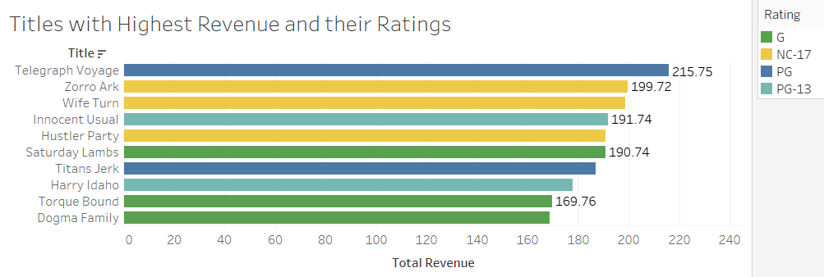
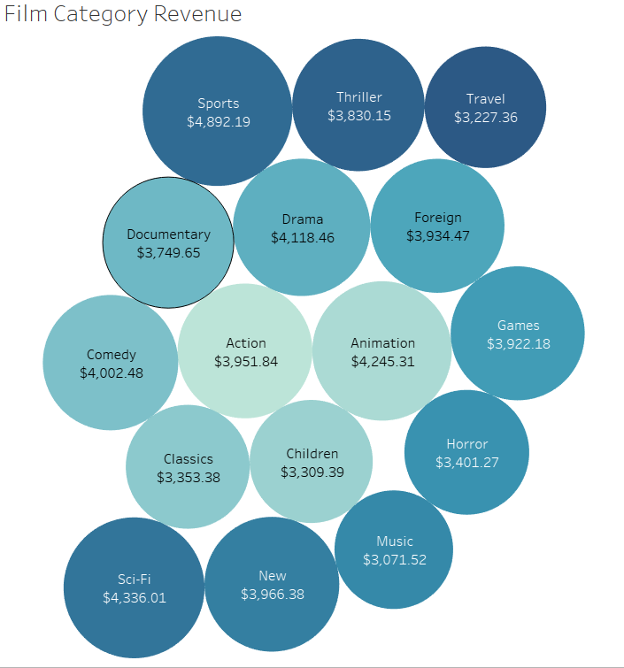
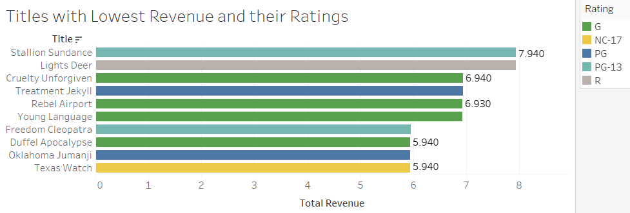
What are Rockbuster’s Most and Least Popular Films & Film Categories?
The revenues generated within each film category are similar to each other. However, Sports was the highest at $4,892.19.

Slide 5
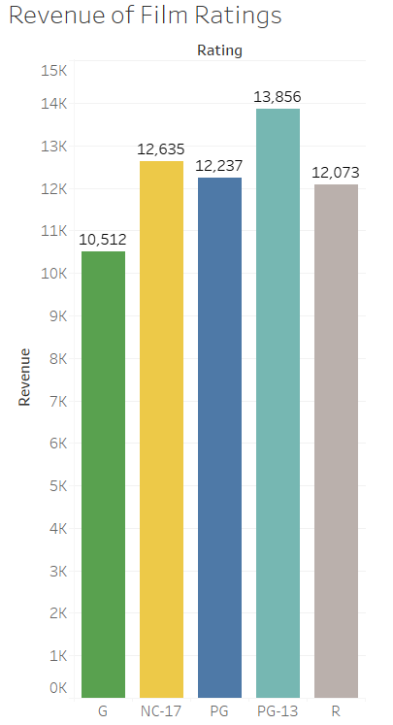

Rental & Film Ratings Information
Minimum: 3 days
Maximum: 7 days
Maximum: 7 days
The most popular Rating category to rent are PG-13

Slide 6
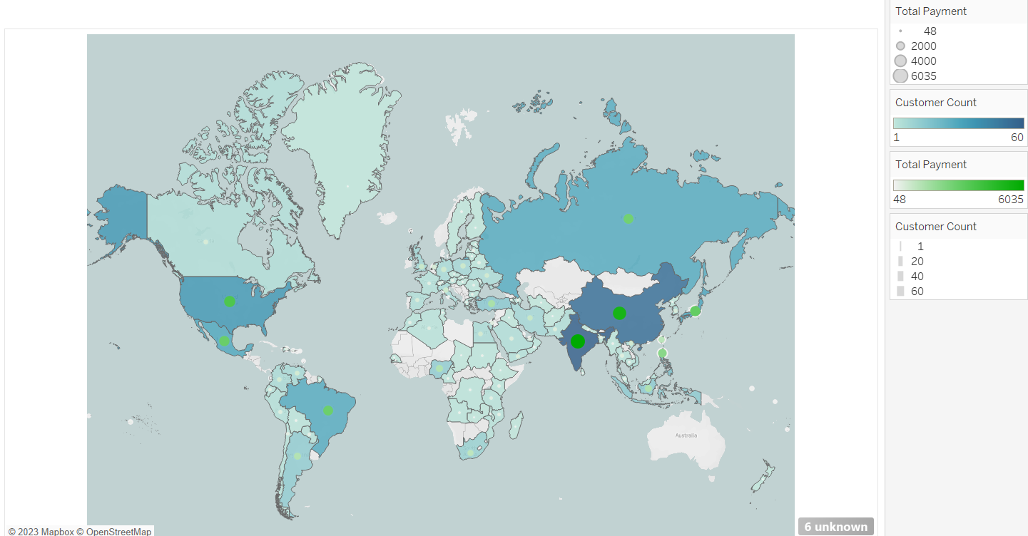
Where is Rockbuster most profitable?
Top 10 Countries by Revenue
India
China
United States
Japan
Mexico
Brazil
Russian Federation
Philippines
Turkey
Indonesia
United States $3685
Mexico $2985
India $6035
China $5251
Japan $3123

Slide 7
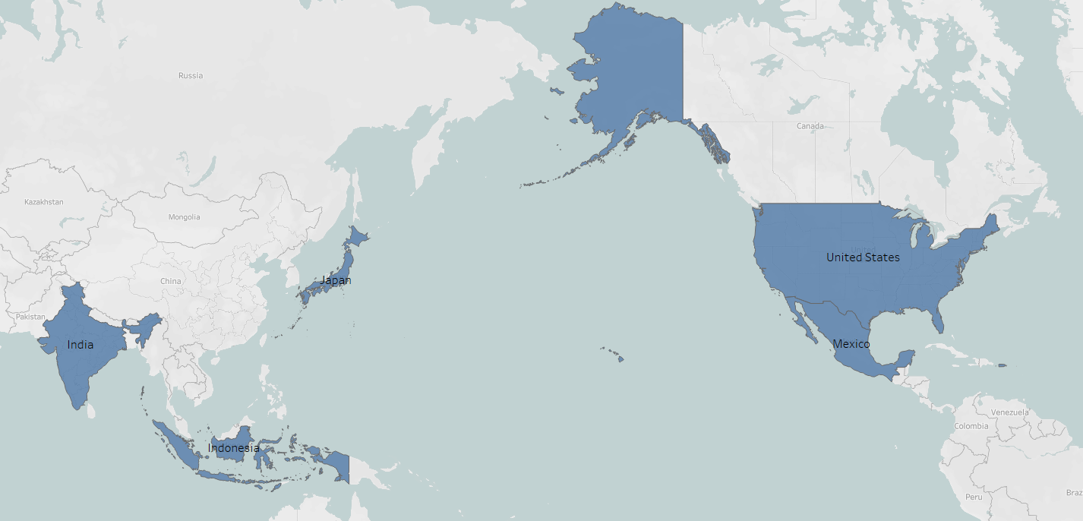
Where are Rockbuster’s Top 5 Customers Located?
1. Glen Talbert | Acua | Mexico
2. Scott Shelley | Aurora | United States
3. Norman Currier | Cianjur | Indonesia
4. Arlene Harvey | Ambattur | India
5. Marlene | Welch | Japan

Slide 8

Conclusions & Recommendations
Rockbuster has 599 customers throughout 109 countries, with the top 5 most profitable countries being India, China, United States, Japan, and Mexico.
It is recommended to start the streaming service within the top 5 countries and begin by including only the most profitable films and film categories and gradually introducing more as the streaming service becomes more popular.
Approach the marketing team to request a promotion be created to drive new subscribers to Rockbuster and also to keep current customers interested.

Slide 9

Thank you!
You can find all visuals within Tableau Pulblic: Profile - lindsey7670 | Tableau Public For any additional questions or resources please contact
Lindsey Young
lyoung@rockbuster.com

